Slide 1

Financial Sustainability
in the
Club and Hospitality Industry
Peter B. Miller, RS,

Slide 2
Sustainable:
Sustainable Harvest
Sustainable Development
Sustainable Environmental Practices
Sustainable Fisheries Practices
Sustainable Construction
Sustainable Energy
Sustainable Growth
Sustainable Crop Rotation

Slide 3
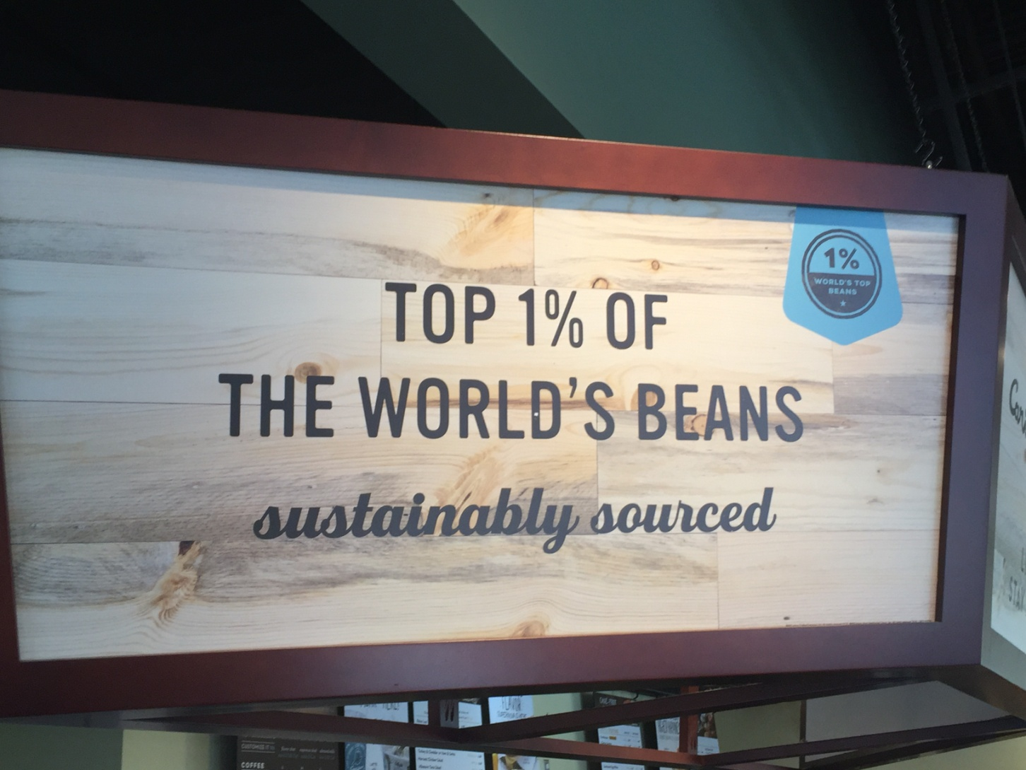

Slide 4
Definition: Sustainability:
dictionary.cambridge.org/us/dictionary/english/sustainability
sustainability meaning: 1. the quality of being able to continue over a period of time.

Slide 5
Definition: Sustainable:
UN World Commission on Environment and Development:
“sustainable development is development that meets the needs of the present without compromising the ability of future generations to meet their own needs.”

Slide 6
To be “sustainable”
“Meet the needs of the present, without compromising the ability of future (owners, members, operators) to meet their own needs.”

Slide 7
That raises the questions:
Whose present needs are we planning for?
What are their needs in the present?
Whose future needs are we planning for?
What are their needs in the future?

Slide 8
Community Associations:
“Meet the needs of the present owners,
without compromising the ability of future owners to meet their own needs.”

Slide 9
Sustainability question:
Whose needs are we planning for in the present?
A: Current Owners
What are their needs in the present?
A: Well maintained communities and low assessments!
AKA: High Property Value

Slide 10
Sustainability question:
Whose needs are we planning for in the future?
A: Current and Future Owners
What are their needs in the future?
A: Well maintained communities and low assessments!
AKA: High Property Value

Slide 11
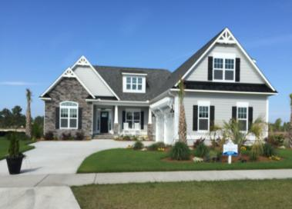
“Perhaps the greatest
Duty of the Board of
Directors is to Protect,
Preserve and Enhance
the value of the homes
within the community!”
Robert Lyles, Esq. Charleston, SC

Slide 12
Applicable to Clubs?
“Perhaps the greatest Duty of the Board of Directors of a Club is to Protect, Preserve and Enhance the value of the membership to the members of the Club!”

Slide 13
Applied to Hospitality?
“Perhaps the greatest Duty of the Board of Directors (or Corporate Executives, or Etc.) of a hotel group is to Protect, Preserve and Enhance the value of the experience to the visitors or clientele!”

Slide 14
Community Associations
Clubs
Hospitality Groups
What’s the common thread?
A: “Brick & Mortar” Facilities that need to be maintained over time!

Slide 15
Financially Sustainable
Operations
Expenses
Annual Budget
Maintenance
Expenses
Replacement Reserves

Slide 16
Financially Sustainable Community
Annual Budget is balanced and adequate…
Normal Assessments are stable…, not stagnant!
Normal Assessments increase appropriately each year with Inflation (PPI not CPI).
Property Values are Protected, Preserved & Enhanced!
You are Financially Sustainable!

Slide 17

Meet Betty Jones!
Retired school teacher;
Lives on a fixed income;
Has lived in her HOA for 20 years;
She is the ideal neighbor! Almost family!
As a member of the Board of Directors, you are foreclosing on her home!
Notes:
Had her over for dinner
She babysat your kids

Slide 18
How Could This Happen?
Lack of Planning on the part of the Board!
Resulted in a Special Assessment,
or
Resulted in precipitous increases in Normal Assessments!

Slide 19
Beware the Unintended Consequences!

Slide 20
Food for Thought:
Almost all CIC financial disasters result, not from an event, but
from lack of planning!

Slide 21


The Clarks – considering whether to continue their club membership.
Their considerations:
Dues are getting higher,
Facility feels tired, outdated,
The big special assessment that’s planned for pool renovation worries them
Membership just doesn’t hold the same value anymore.

Slide 22

Debbie Norris –
Thinking about giving up her old vacation membership.
Can’t travel as often with the new job.
Maintenance fees have gotten really high!
The newer vacation clubs have much more modern amenities and features.

Slide 23
Financially Sustainable
Operations
Expenses
Annual Budget
Maintenance
Expenses
Replacement Reserves

Slide 24
Benefits of Reserve Study
More accurate long-term financial planning.
Ability to consider when to replace and/or upgrade as part of long-term planning.
Ability to institute more cost-effective facilities maintenance practices.
Mitigate unnecessary losses due to bad facilities maintenance practices.

Slide 25
Module 2
Sample
Reserve Study

Slide 26
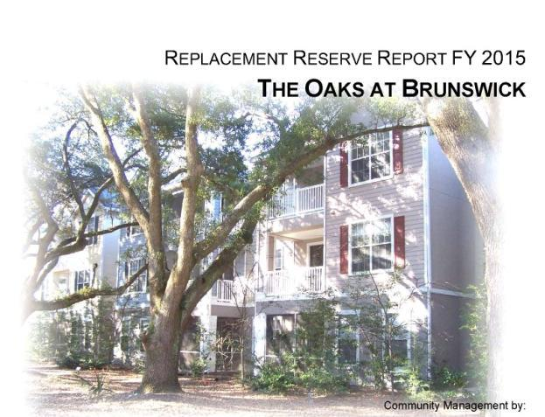

Slide 27
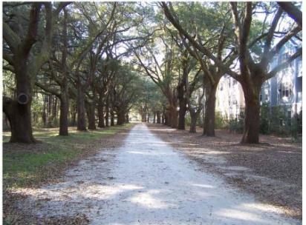

Slide 28
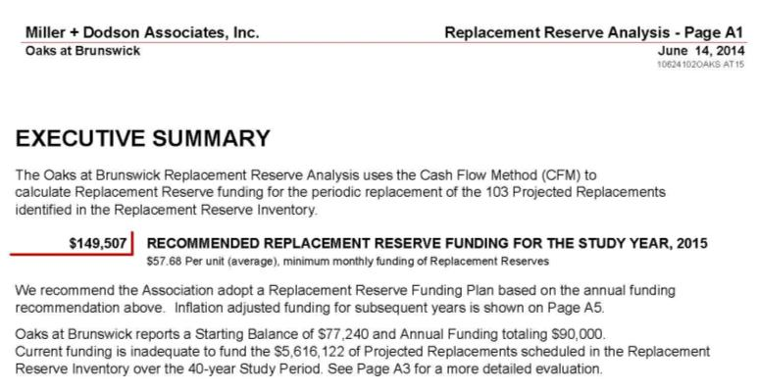

Slide 29
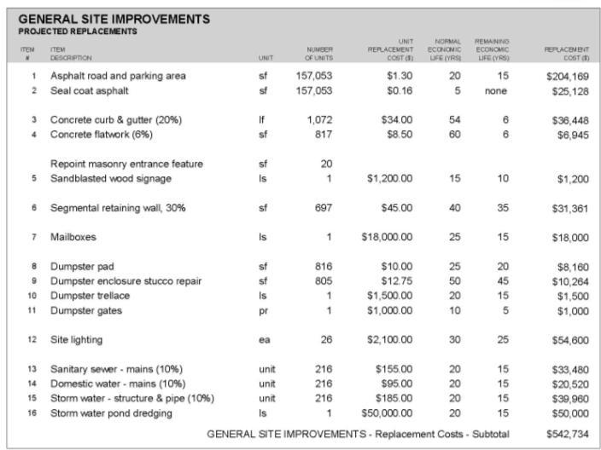

Slide 30
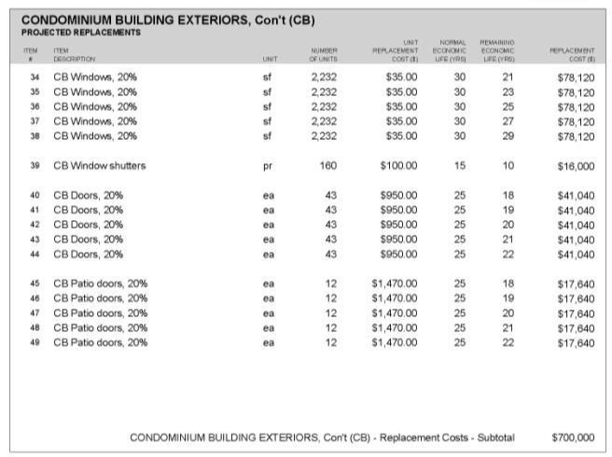

Slide 31
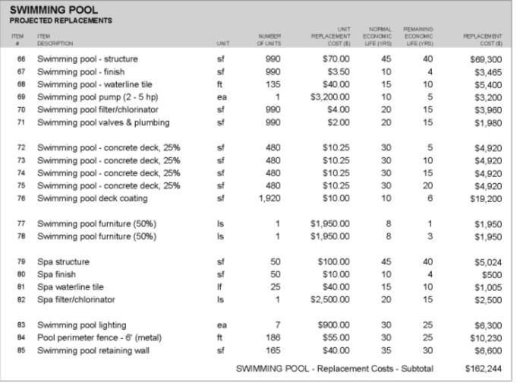

Slide 32
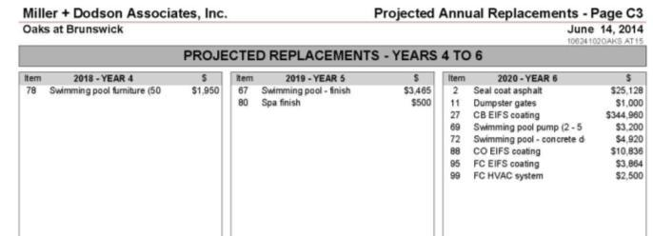
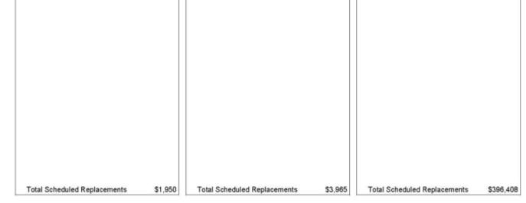

Slide 33
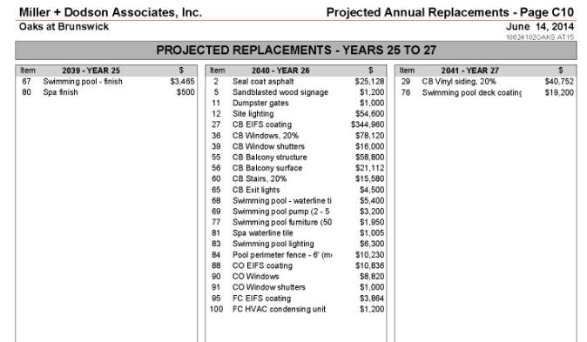


Slide 34
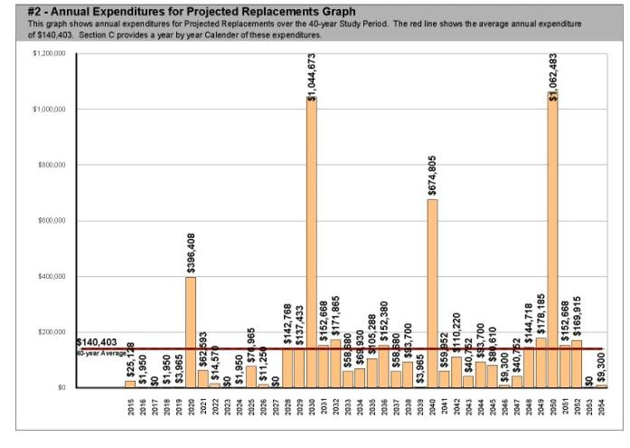

Slide 35
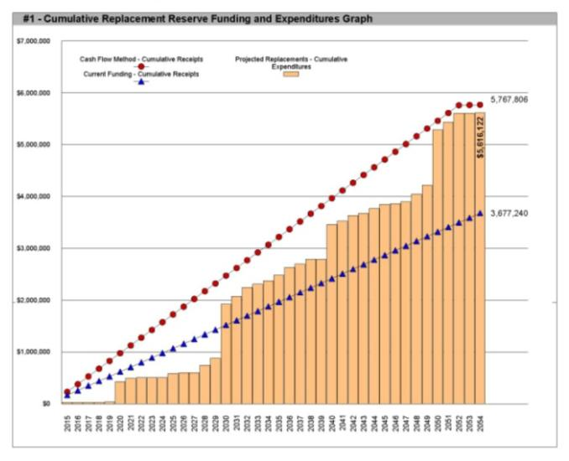

Slide 36
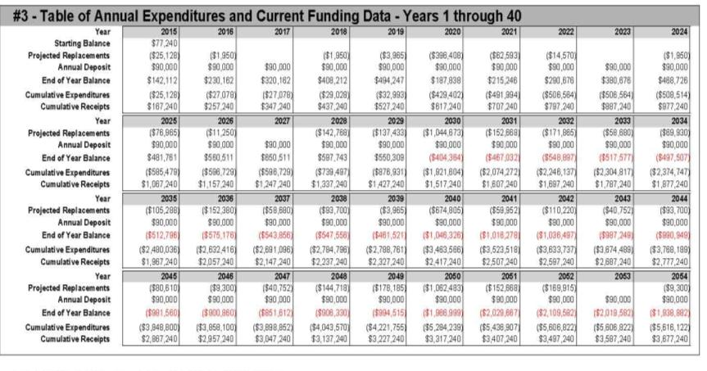
Cash Flow Margins until 2030

Slide 37
Understand Inflation -
CPI vs PPI
Consumer Price Index (CPI)
  Food Costs
  Fuel Costs
  Electricity Costs
  Housing Costs (meaning rent)
Producer Price Index (PPI)
  Manufacturing costs
  Construction costs

Slide 38
Questions

