Slide 1
Global Expansion
HFTP Association Global Update

Slide 3
HFTP History
Founded in 1952, HFTP is a global nonprofit hospitality association that uniquely understands the industry’s problems.
HFTP’s roots stem from a number of state-centered accountant associations.
Supported by Texas Hotel Accountants Association and the Hotel Accountants of New York.
Formal organization of the National Association of Hotel Accountants was formed on October 26, 1952 in New York City at the Hotel Lexington.
Notes:
National Association of Hotel Accountants
National Association of Hotel-Motel Accountants
International Association of Hospitality Accountants
Hospitality Financial and Technology Professionals

Slide 4
About HFTP
HFTP is a global hospitality association for finance and technology professionals working in hotels, clubs, and other hospitality-related businesses.
Provides first-class educational opportunities, networking and resources to members and industry stakeholders around the globe.
HFTP is the only nonprofit association that produces finance and technology events globally.
Recognized as the spokes group for the finance and technology segment of the hospitality industry.

Slide 5
HFTP Purpose
To lead and advance the hospitality profession by providing a forum for continuous learning and knowledge sharing.

Slide 6
Hospitality Financial and Technology Professionals (HFTP®) established in 1952, is an international, nonprofit association, headquartered in Austin, Texas, USA, with offices in Hong Kong, United Kingdom, Dubai and the Netherlands. HFTP is recognized as the spokes group for the finance and technology segments of the hospitality industry with members and stakeholders spanning across the globe. HFTP uniquely understands the industry's pressing issues and assists its stakeholders in finding solutions to their challenges more efficiently than any organization. It does this via its expert networks, research, certification programs, information resources and conferences/events such as HITEC. HFTP also owns the world's only hospitality-specific search engine, PineappleSearch.com.

Slide 7
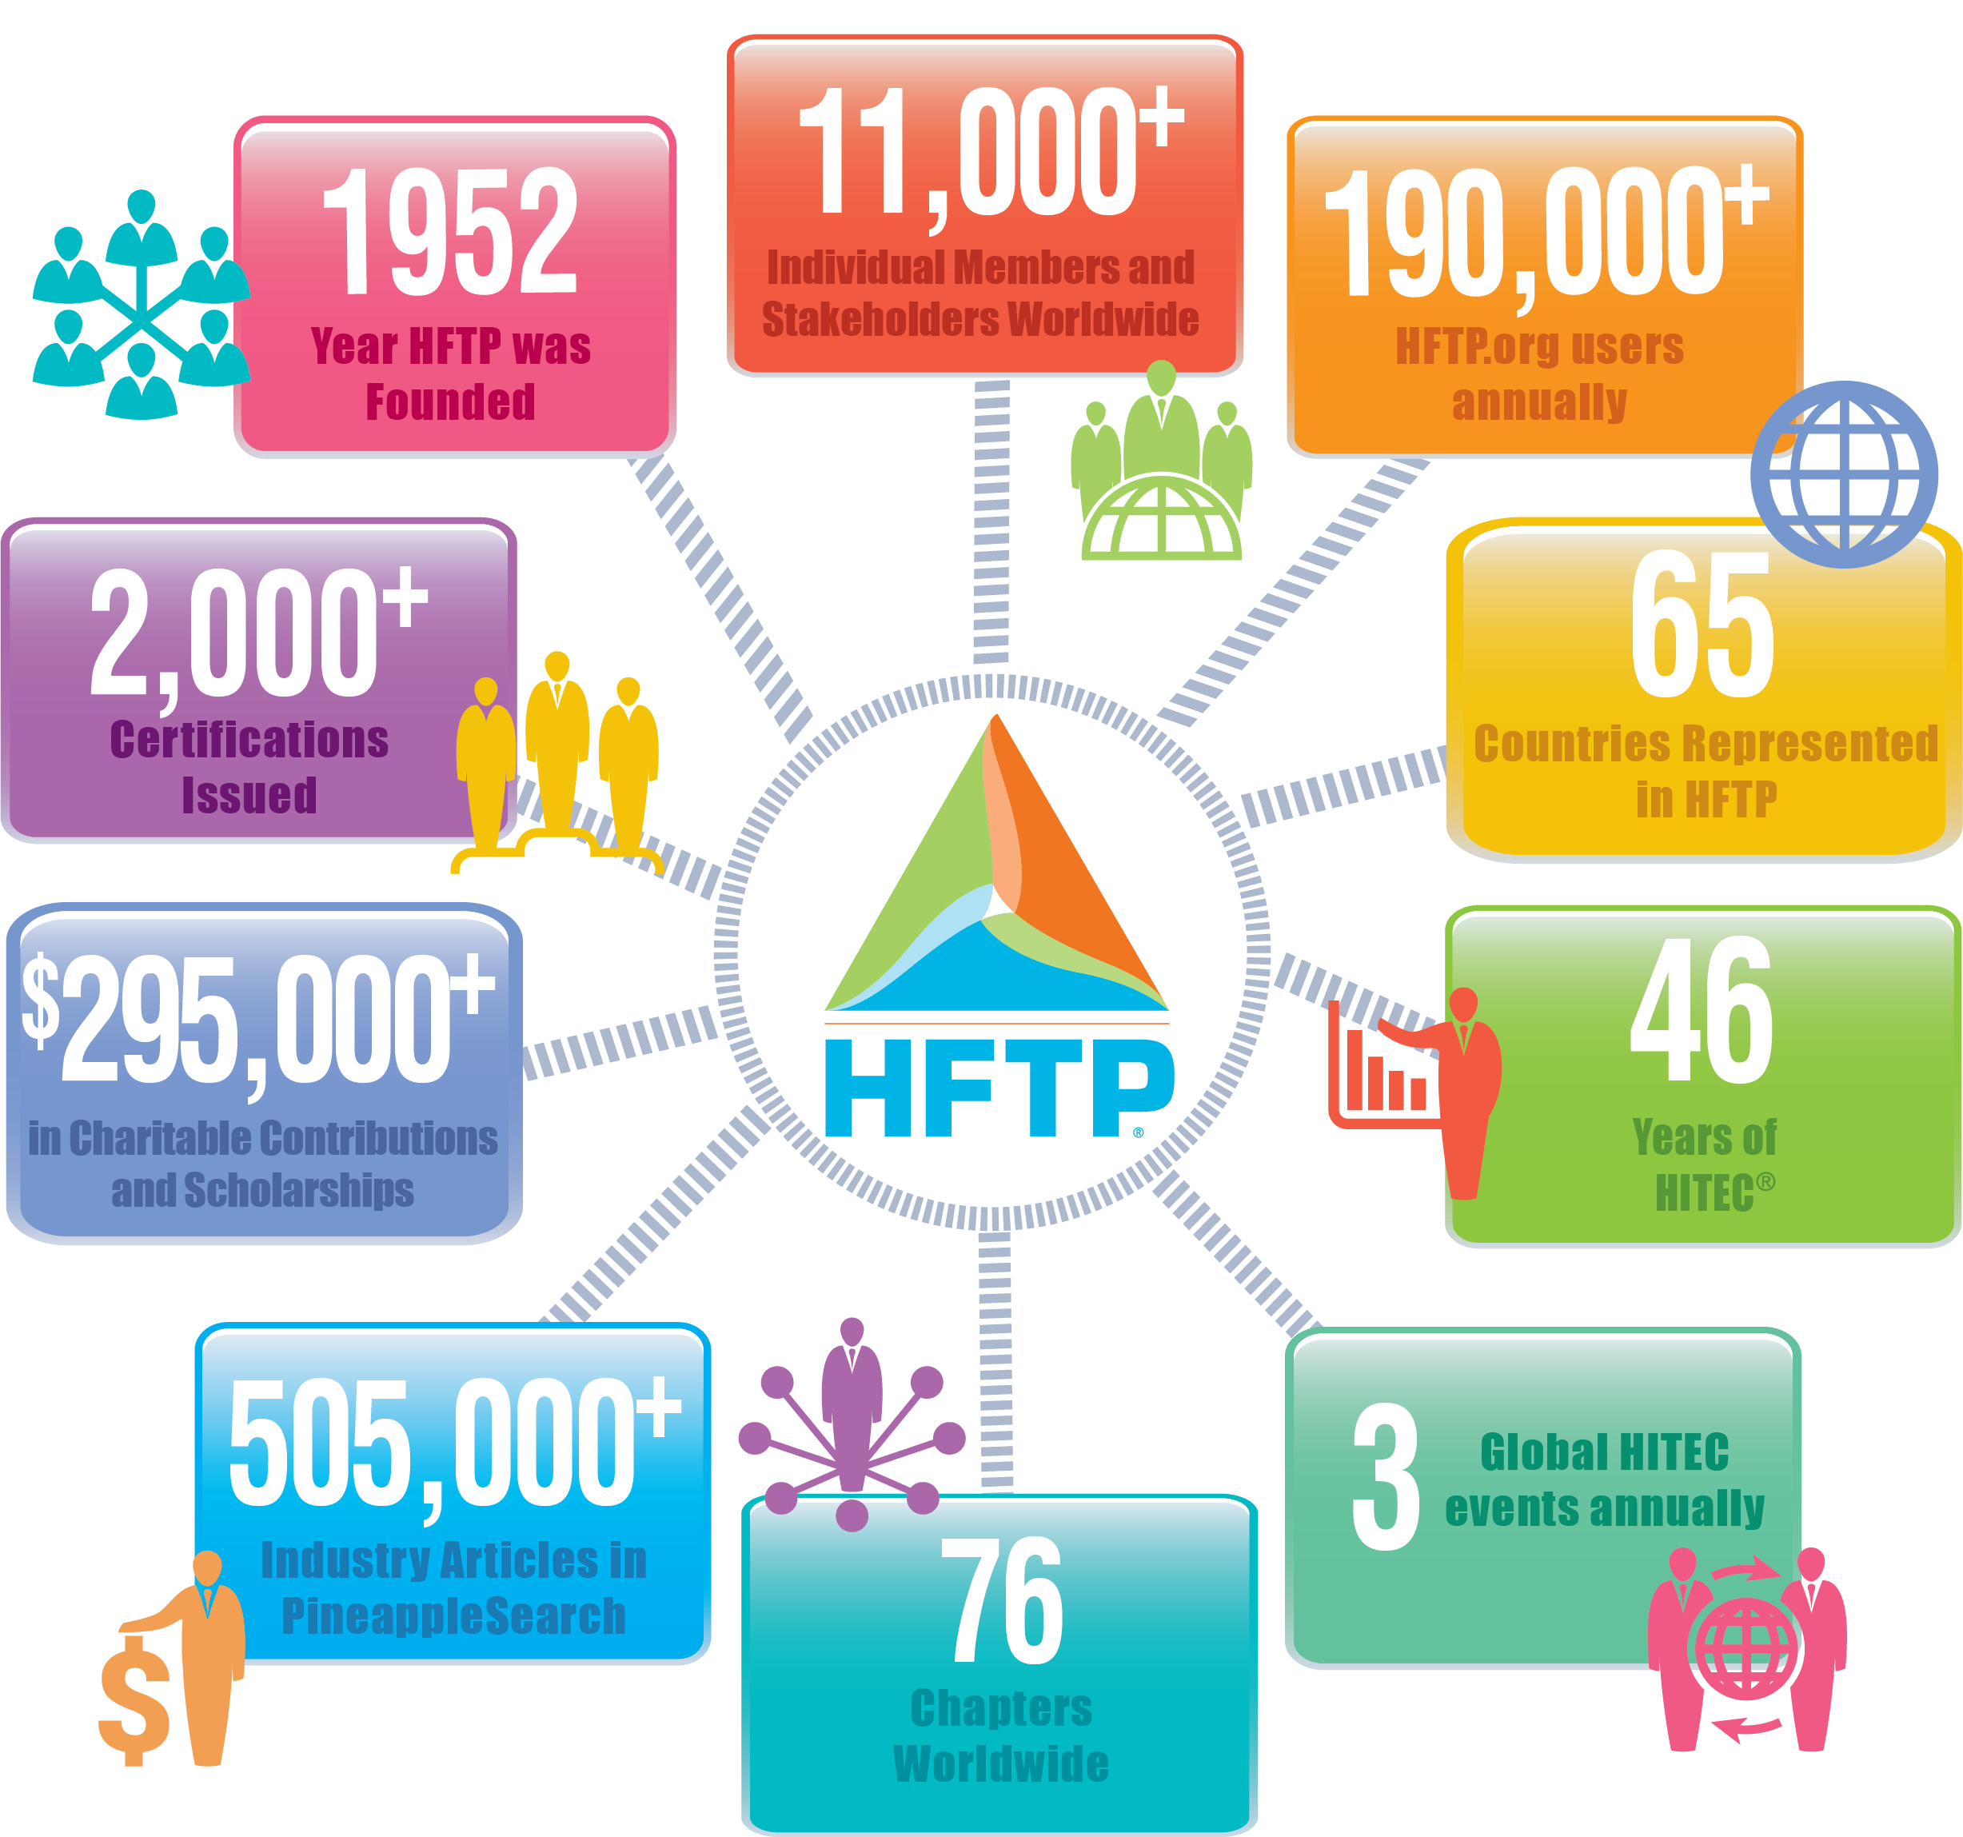
(as of 10/18)
Updated annually

Slide 9
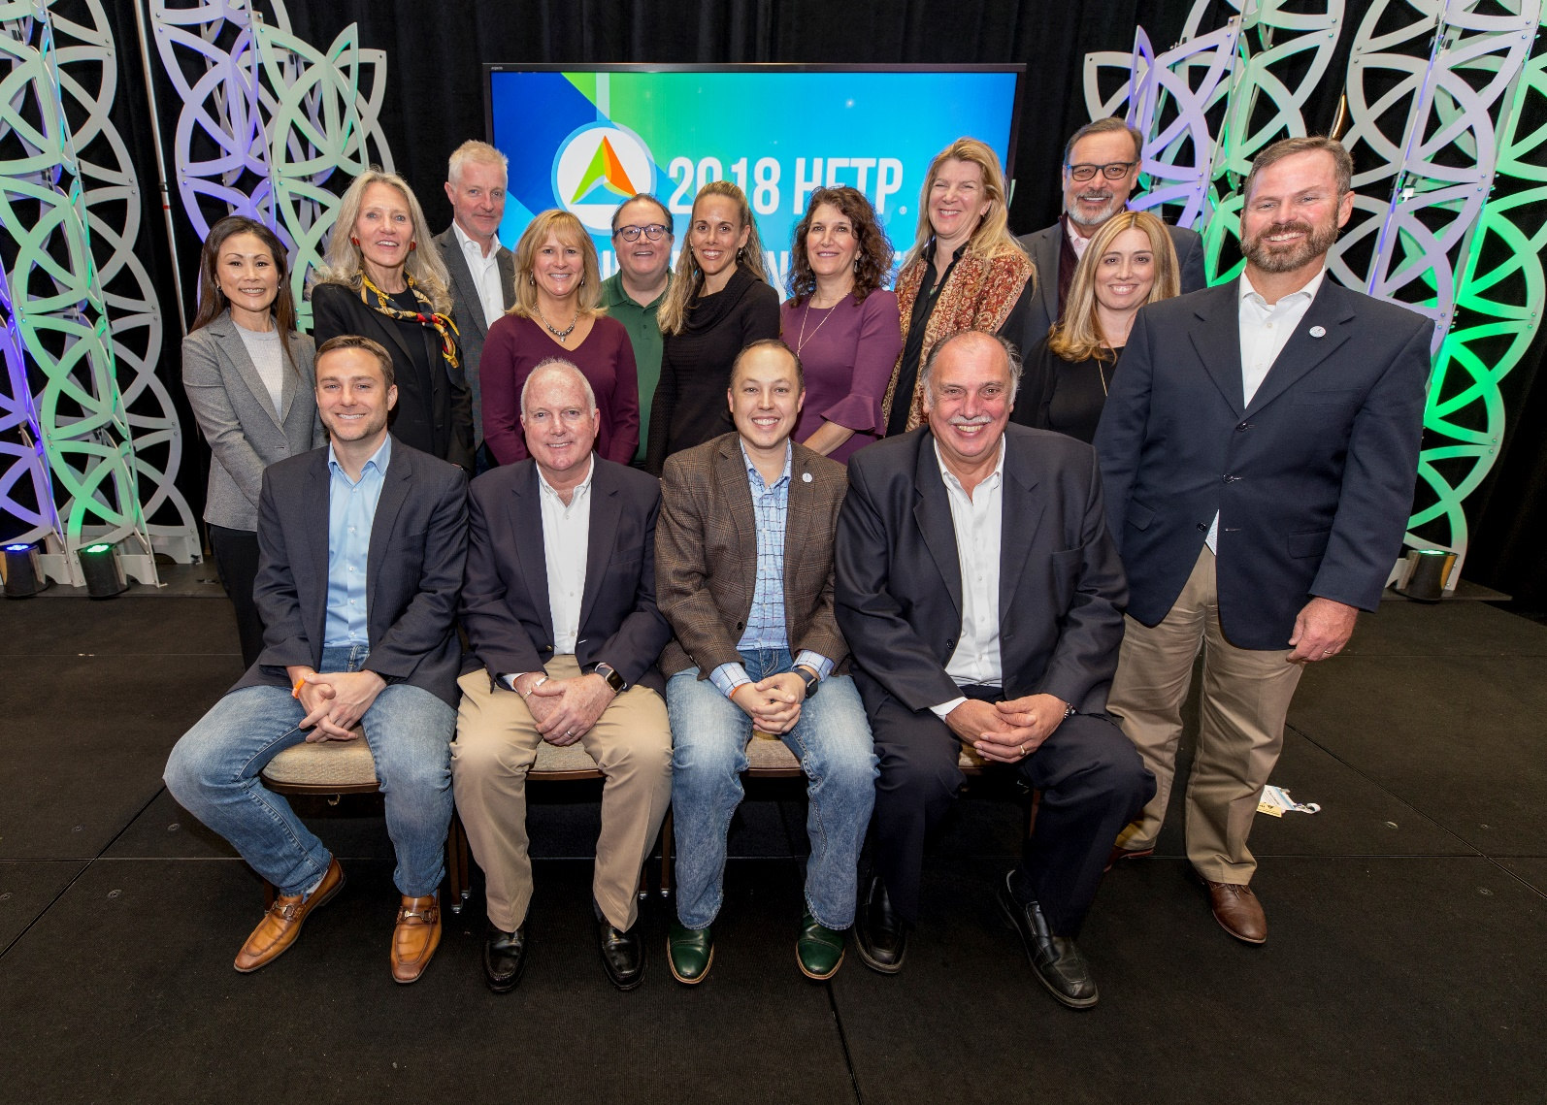
2018-2019 HFTP Board of Directors

Slide 10
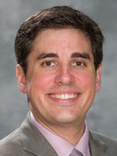
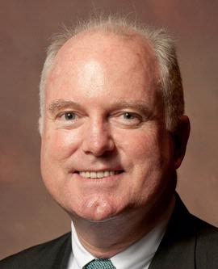
2018-2019 HFTP GLOBAL BOARD
From left to right:
President Scot Campbell, CHTP, is CTO at North American Concerts – LiveNation.
Vice President is Michael Levie, CHTP, is CEO at citizenM.
Treasurer Mark Pate Sr., CHAE, CHTP, MBA is Assistant Controller & IT Director at Highpointe Hotel Corporation.
Secretary Neil Foster, CHTP, MBA is IT consultant at Tech-Tonic Hospitality Solutions.
Immediate Past President Timothy Nauss, CHAE, is CFO at Macao Studio City.
Executive Advisor Stephanie Anderson, CHAE, CPA, CGMA is CFO at River Bend Golf and Country Club.

Slide 11
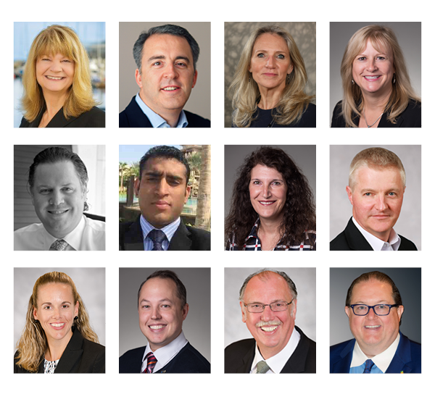
HFTP 2018-2019 GLOBAL DIRECTORS
Notes:
Directors:
Stephanie Anderson, CHAE, CPA
Cindy Braak
Cindy Estis Green
Amirul Islam
Sherry Marek
Martha Mazzitelli, CHAE+, CHTP+
Nick Price
Laurie Rozwski, CHAE, MBA Kaeko Shirasu-Bailey, CPA
Dr. Justin Taillon
Derek Wood
Ex Officio – Frank Wolfe, CAE

Slide 13
HFTP Member Services
As of January, 2019, HFTP has:
Global Members
4,256
Global Chapters
59
Student Chapters
24

Slide 14
HFTP Membership
HFTP members range from hospitality students to c-level executives. The association offers a variety of member categories that meet specific needs to hospitality finance and technology professionals.

Slide 15
HFTP Dues Structure
Membership Dues: $415 USD/year
Young Professionals: $200 USD/year
Student Memberships: FREE
Global Membership Dues Pricing Available
Multiyear pricing available

Slide 16
HFTP Membership Benefits
Make Meaningful Connections
Gain Industry Knowledge
Advance Your Career
Access Useful Tools
Develop New Skills

Slide 17
HFTP Membership Programs & Services
HFTP Publications and Research Reports
HFTP Connect (Blog)
Webinars
Certifications
Community@HFTP
The Global Hospitality Accounting Common Practices
HFTP Member Consultants
Career Center
Industry Research & Centers
Industry Reference Texts
Pineapplesearch
HFTP News Sites: HFTP News, HITEC Bytes, Finance Bytes , GDPR Bytes, F&B Bytes and Club Bytes
Chapters
Member Pricing Discounts
Networking
Global Events and Conferences

Slide 18
Member Benefits and Resources
Chapter Involvement
Networking Opportunities
HFTP Publications
Communities
Resources
HFTP Events
Continuing Education
News Sites and More

Slide 19
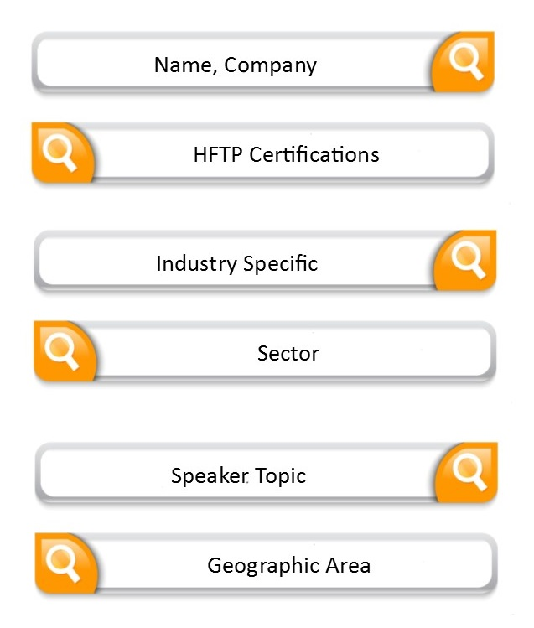
HFTP Member Consultants
Searchable Directory of Consultant Members
Consultants specialize in various aspects of the hospitality Industry
Accounting
Finance
Technology
Human Resources
Legal Issues
Interested in being listed?
Register @ www.HFTP.org
Education & Resources
HFTP Member Consultants
Complete the Consultant Listing Form
Exclusively for HFTP Members
Search By:
Notes:
Industry Specific (Cybersecurity, Employee Benefits, Fraud, Tax)
Sector (Hotels, Casinos, Clubs, Restaurants, Theme Parks)
Speaker Topic (Cloud services, Forecast/budgeting, PCI Compliance)

Slide 20
HFTP Member Benefit
AICPA (American Institute of Certified Public Accountants) is a partnership has being created with HFTP and AICPA.
HFTP Members are now eligible to receive a discounted rate on pre-approved ethics courses offered by AICPA.
Website: http://www.cpa2biz.com/
Coupon code: HFTP14 Discount: 10%
Selected Topics in Professional Ethics (Product #158387)
Cost and Return: Professional Ethics in Business (Product #159891)
Professional Ethics: 2012-2013 Update and Refresher (Product #159434)
Professional Ethics for CPAs in Business (Product #158902)

Slide 21
HFTP Member Benefit
The UPS® Savings Program allows members to ship and save with UPS®.
Improve your bottom line with some of the most competitive rates available on shipping services with UPS®.
Enroll in the UPS Savings Program and save up to 34% on a broad portfolio of shipping services.
To enroll and start saving today, visit savewithups.com/hftp or call 1-800-MEMBERS (1-800-636-2377).

Slide 22
HFTP Member Benefit
Three Research Centers
Conrad N. Hilton, University of Houston
Hong Kong Polytechnic University
Emirates Academy (Dubai)
FREE service for dues-paying members
Answers hospitality industry-related questions for HFTP members
Researches and publishes industry topics including the bi-annual HFTP Compensation and Benefits Survey.
Notes:
Tanya Venegas, MBA,MHM
Executive Director of the Research Institute
University of Houston
Evita Ma Executive Director School of Hotel & Tourism Management The Hong Kong Polytechnic University

Slide 24
HFTP Publications
Hotel Yearbook
HITEC News Flash
HITEC Bytes Special Report
HFTP News Site and e-Newsletter
HITEC Bytes Site and e-Newsletter
HFTP Club Bytes Site and e-Newsletter
HFTP Finance Bytes Site and e-Newsletter
HFTP GDPR Bytes Site and e-Newsletter
HFTP Connect (The Hospitality Professionals’ Blog)

Slide 25
An analysis of IT spending data in the lodging industry and USALI compliance practices by lodging executives.

Slide 26
For 30 years HFTP has been collecting compensation and benefits data from financial and technology professionals. Review the most current information in the recently-released report.

Slide 28
Publications: Industry Reference Texts
Accounting for Club Operations
Uniform System of Accounts for the Lodging Industry, 11th Edition
Uniform System of Financial Reporting for Clubs, 7th Edition
Uniform System of Financial Reporting for Spas

Slide 30
HFTP Resources
HFTP members receive information on the latest industry trends and emerging business practices through a variety of resources and tools.

Slide 31
HFTP Online Resources
PineappleSearch.com is the world’s only hospitality industry specific search site.
Global Hospitality Accounting Common Practices (GHACP) is a tool that allows users to compare global hospitality accounting practices from five different countries, plus the Uniform System of Accounts for the Lodging Industry (USALI), 10th and 11th editions.
HFTP launched a series of informational websites in 2016 including: HFTP News; HFTP Club Bytes; HFTP Finance Bytes; HITEC Bytes; F&B Bytes and GDPR Bytes.

Slide 32
Online Resource: PineappleSearch.com
PineappleSearch.com is an hospitality industry specific search site.
The site is an aggregated content destination that focuses on news, articles and reports of primary interest to the hospitality industry, with priority placed on information-based results.
PineappleSearch.com is produced by HFTP and powered by hsyndicate.

Slide 33
HFTP Member Benefit Job Descriptions on Pineapplesearch.com
Club Accounting
Accounts Payable Clerk
Lodging Accounting
Accounts Payable Manager
Accounts Receivable Manager
Assistant Controller
Assistant Director of Finance
Chief Financial Officer
Controller
Corporate Controller
Director of Finance
Internal Auditor
Regional Controller
Staff Accountant
Vice President of Finance
Accounts Receivable Clerk
Assistant Controller
Bookkeeper
Controller
Chief Financial Officer
Payroll Clerk
Receiving and Storeroom Clerk

Slide 34
Online Resource: Community@HFTP
Community@HFTP is an online resource which provides an environment for all of HFTP’s members to collaborate and exchange resources with each other no matter where they are in the world.
The goal of Community@HFTP is to be a supportive space that fosters dialogue and promotes knowledge sharing.

Slide 35
HFTP Additional Resources
Job Board
HFTP Research Centers
HFTP Scholarships & Endowments
Discounts on Industry Reference Texts
ProLinks Webinars and Webinar Archives
Practice exams for CHAE & CHTP certifications

Slide 36
Resources: HFTP Job Board
HFTP Members can search jobs and find opportunities to advance their careers.
Employers can post job openings.
Free Service to the Industry!

Slide 37
Resources: Industry Certifications
HFTP administers these examinations and awards these designations:
Certified Hospitality Accountant Executive (CHAE®)
Certified Hospitality Technology Professional (CHTP®)
Contact :
HFTP Certification Manager
Robin.Bogdon@hftp.org

Slide 38
Certification Advisory Program
HFTP recently launched the CAP program designed to assist CHAE and CHTP certification applicants in achieving the HFTP certifications.
The NEW Certification Advisory Program brings together both candidates and advisors, who will help and support candidates in one-to-one interactions, as a supplemental review option for the certification exams.
The Certification Advisory Program is also looking for experienced HFTP designee advisors.

Slide 39
Certification Advisory Program
What is Involved in Being a CAP Advisor?
Advisors must be an HFTP member and also an ACTIVE designee (CHAE or CHTP) status.
One (1) year commitment, cannot serve consecutive years.
One (1) candidate per six (6) month period. (unless additional candidates are approved by Advisory Council)
Monthly commitment will be a minimum of two hours. (via conference call, email and/or face-to-face – if possible)
Approved Certification Advisory Program advisors earn CPE credits.

Slide 40
Certification Advisory Program
How Can I Apply to Be An Advisor?
To be considered as a CAP advisor, applicants must submit the program application.
Once the advisor application is submitted, there is an approval process in which applicants will be notified after review.
Advisors will be provided tools and resources to assist in their training before being matched with a candidate.
If you are interested in being considered for an advisor, please submit the CAP application today.

Slide 41
Resources: Industry Certifications
CHAE and CHTP designees are able to keep track of their CPE credits on the HFTP website.
Not only can you see your CPE credits for your CHAE and CHTP, you can also enter credits towards other designations you have.

Slide 43
HFTP Club Summit

Slide 44
HITEC
Europe
https://www.HITEC.org/europe

Slide 45
HITEC
North America
https://www.HITEC.org/minneapolis

Slide 46
Now Accepting Applications! E20X Mallorca: April 9, 2019 at HITEC Europe E20X Minneapolis: June 17, 2019 at HITEC Minneapolis
Entrepreneur20X – HITEC Europe 2019
The 11 participants took the stage for four minutes each to pitch their company, and why their product or service will be the next best thing
Pitchers presented to a packed session room and a panel of judges
Grand prize - E20X Judge’s Award winner: KITRO
People’s Startup Award: ARRIVEDO
Entrepreneur20X – HITEC Houston 2018
The 16 participants took the stage for four minutes each to pitch their company, and why their product or service will be the next best thing
Pitchers presented to a packed session room and a panel of judges
Grand prize - E20X Judge’s Award winner: REPLAY.AI
People’s Startup Award: BEEKEEPER

Slide 47
2019 HFTP Global Events
HITEC Europe Palau de Congressos • Palma de Mallorca, Spain | April 9-11, 2019
HFTP Club Summit Nashville, Tennessee USA | March 11-12, 2019
HITEC Minneapolis Minneapolis Convention Center • Minneapolis, Minnesota USA | June 17-20, 2019
HFTP Club and Hotel Controllers Conference Minneapolis Convention Center • Minneapolis, Minnesota USA | June 17-19, 2019
HFTP Leadership Workshop Rosen Centre Hotel • Orlando, Florida USA | October 22, 2019
HFTP Annual Convention Rosen Centre Hotel • Orlando, Florida USA | October 23-25, 2019

Slide 48
HFTP 2019 Chapter Regional Events
HFTP Mid-South Atlantic Regional Conference Williamsburg Lodge •Williamsburg, Virginia USA | February 14-16, 2019
HFTP Mid-West Regional Conference | 2019
HFTP Texas Regional Conference | 2019
HFTP Florida Regional Conference | 2019
Notes:
2018 HFTP MID-SOUTH ATLANTIC REGIONAL CONFERENCE
Hosted By:
HFTP Central Carolina Chapter
HFTP Charlotte-Blue Ridge Chapter
HFTP South Carolina Chapter
HFTP Central Virginia Chapter
2018 HFTP Florida Regional Conference
Hosted by the Manasota Chapter and the Gulf Chapter

Slide 49
HFTP ProLinks Webinars
Recent webinars:
Artificial Intelligence and Big Data for the Hospitality Industry Presented by Kanishka Agiwal
Mapping the Travel Journey of the Chinese Tourist Presented by Charlene Ree
Eight Steps to Becoming a Trusted Advisor to Your Customers Presented by Natalie Doyle Oldfield
Visit the HFTP website’s “Webinars” page to learn more and register.
HFTP Webinars and archived recordings are free to members!

Slide 51
Follow HFTP on Social Media
HFTP hftp.org
HFTP Facebook Facebook.com/HFTPGlobal
HITEC Facebook Facebook.com/HITECconference
Twitter @HFTP & #HFTP
Instagram @HFTP_HITEC
YouTube youtube.com/HFTPandHITEC
LinkedIn Hospitality Financial and Technology Professionals
Flickr flickr.com/photos/hftphitec
Notes:
51

Slide 52
Read HFTP Connect, the official HFTP blog, at
blog.hftp.org

Slide 54
HFTP International Office Locations
HFTP GLOBAL HEADQUARTERS
11709 Boulder Lane, Suite 110 Austin, Texas 78726 USA
Hours of Operation:
Monday–Friday 5:30 a.m. – 6:30 p.m. CST
Toll Free: (800) 646-HFTP (4387) US Ph: +1 (512) 249-5333 Fax: +1 (512) 249-1533 Skype: HFTP.Global
HFTP EUROPE OFFICES
Boschcour 54 6221JR Maastricht The Netherlands Ph: 0808 234 6808 (UK Only) Ph: +44 808 234 6808
HFTP AMERICAS RESEARCH CENTER
Conrad N Hilton College University of Houston 229 C N Hilton Hotel & College Houston, TX 77204-3028
Toll Free: (866) 572-HFTP Ph: +1 (713) 743-1839
HFTP ASIA RESEARCH CENTER School of Hotel & Tourism Management The Hong Kong Polytechnic University 17 Science Museum Road TST East, Kowloon, Hong Kong Ph: +1 (512) 220-4039 Skype: HFTP.Asia
HFTP DUBAI RESEARCH CENTER
Emirates Academy
Dubai, United Arab Emirates

Slide 55
Questions/Comments?
Notes:
55

