Slide 1
Winning The War for Talent

Slide 2

About
Living in Cincinnati, OH. Originally from Washington, D.C.
Xavier University Marketing Advisory Board
Co-organizer of Flying Pig PigAbilities
Helped start Green Diamond Gallery & The Character and Courage Foundation in Montgomery, OH
Lead Product Marketing at Paycor
    Partner with Product on Development of New Solutions
    Market Research and Insights
    Compliance Thought Leadership
    HR Thought Leadership
    Customer Experience
    Co-creator of the HR Center of Excellence
Tim Ruge
Director of Product Marketing

Slide 3




Our Research
(Over 2,700 Organizations Researched)
Paycor Survey
3rd Party Survey
(Paycor Commissioned)
Aggregated Customer Data
Interviews
Industry
Experts

Slide 4

66%
of CFOs say their HR departments have an “average or worse than average” impact on the organization.
How is
HR Seen?
<10%
of an HR professionals time is spent aligning with or sharing impact executives.

Slide 5






Six Pillars
of HR Excellence

Slide 6

Consider the Full Employee Lifecycle
The War for Talent Isn’t Just Recruiting
Recruiting Strategy
Employee Retention Strategy

Slide 7

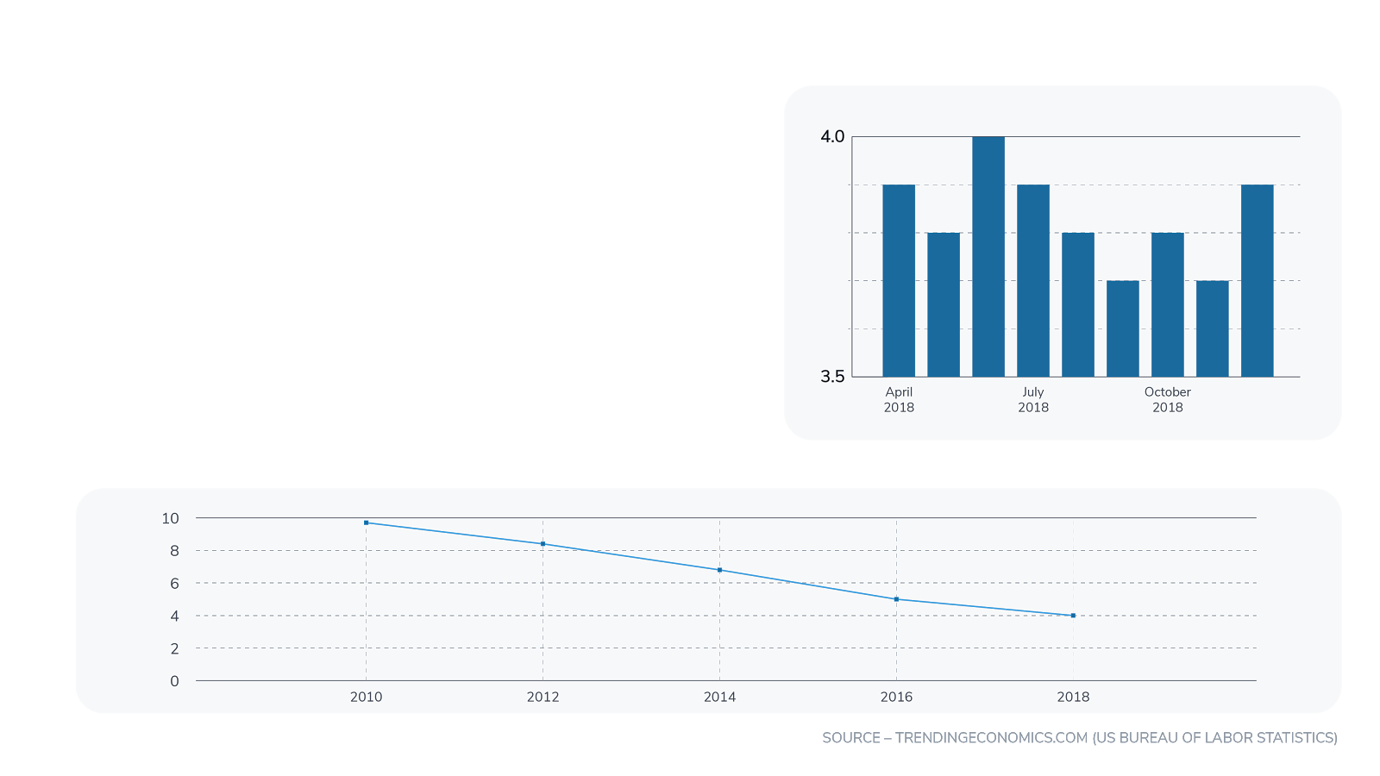
It’s a Candidates Market
The unemployment rate in U.S. is at its lowest rate in the last 10 years
Lower unemployment = you must create demand
Passive recruiting won’t cut it, you must be proactive

Slide 8
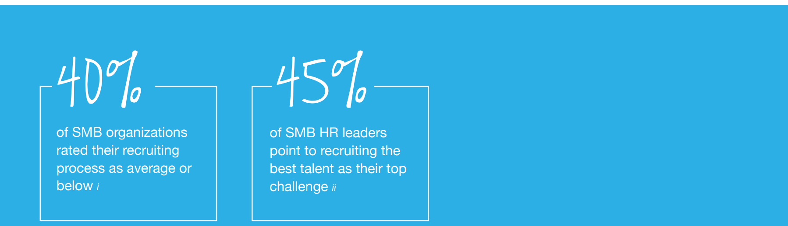
Recruiting
HR’s most important and toughest challenge.

Slide 9
Talent Rules for 2019
1
You have to be metrics focused.
You need a strategy to improve key metrics.
You need to empower each person in the process.
You need to communicate results.
Consider the full employee lifecycle. Put it all together!
2
3
4
5

Slide 10
1. Metrics Focused

Slide 11



Recruiting
Key Metrics
Average Time to Fill
Total # of Days Job is Open
Total # of Jobs Open
Average = 42 Days*
*(SHRM)
Employee Referral Rate
% Hired from Referrals
All Candidates Hired
Average Cost per Hire
Total Internal/External Costs
Total Candidates Hired
Average = $4,129 Days
*(SHRM)

Slide 13

Recruiting
Optimizing Your Candidate Pipeline
Develop an pipeline tracking mechanism in order to anticipate the productivity needs
from an HR perspective (weekly, monthly, quarterly or annually).
Data can be calculated by an HR leader or across the team.
Start benchmarking current state vs where you need to be.
Provides a comparison of what’s needed vs current status.
Notes:
Optimized candidate funnels can be developed in order to anticipate the productivity needs from a Recruiter perspective weekly, monthly, quarterly or annually. The data can be calculated by Recruiter or across the team: provides a comparison regarding what’s needed vs current status in order to drive the targeted capacity (supported by a Recruiting Scorecard and Word Picture).

Slide 14
2. Strategize to Improve

Slide 15
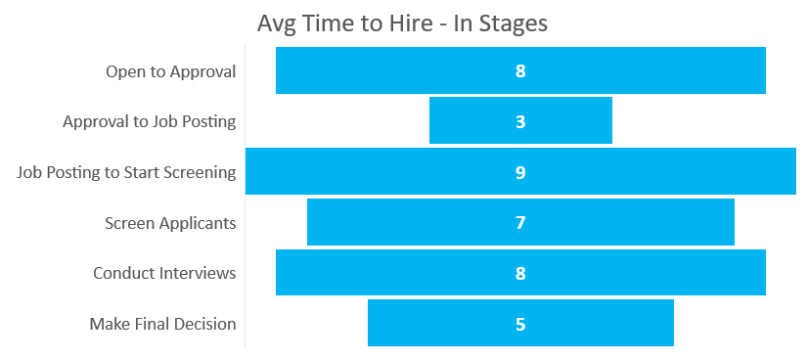
Recruiting
Time to Fill – Reduce by Understanding Your Funnel
*SHRM Talent Management Benchmark 2017

Slide 16

Sourcing Strategy
What does your look like?
Effective sourcing strategies should be equipped with targetedgoals as a percentage of hire.
Sync the percentage of budget spend in each area with targeted goals.
Example:
In FY19, Company A is targeting 35% of all
hires to come from their referral program.

Slide 17
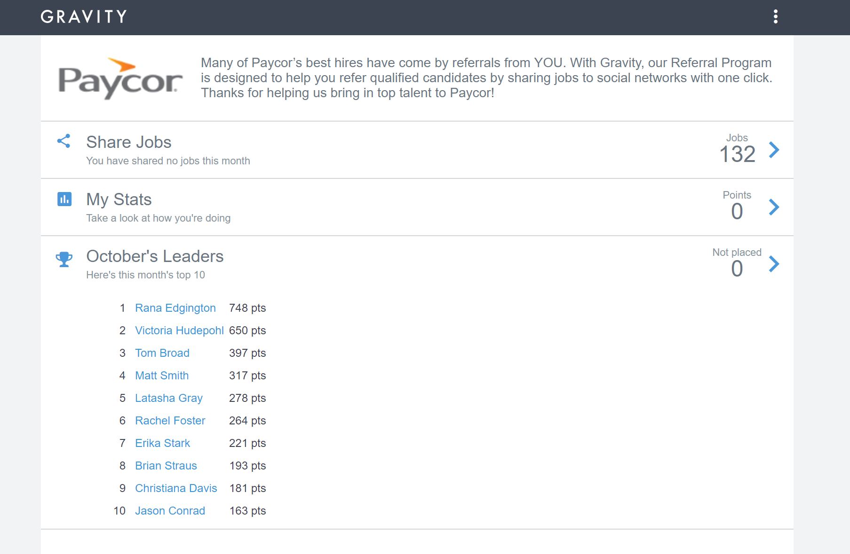
Sourcing Strategy
Leveraging Employee Referrals
Sourcing through referrals
Employee bonus program
Easy sharing of jobs via social media
Scoreboards for top “sharers”
Significant opportunity to grow candidate pipeline

Slide 18
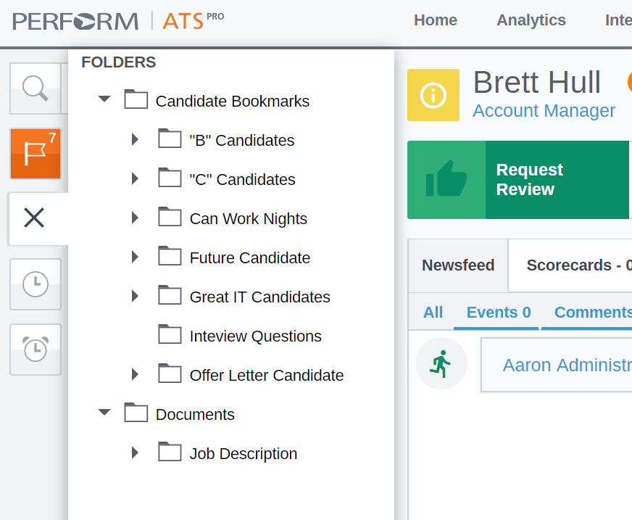
Finding Passive Candidates
How do you manage passive candidates?
  Your Database
  LinkedIn
  Talent Communities
Finding people is hard, how can you find them and create a compelling & personal story that peaks interest?
Personalize your story – you’re marketing to your candidates.

Slide 19
Recruiting
Cost per Hire – More Expensive Than You Think
43%
of organizations don’t know their average Cost Per Hire
42%
Report that their cost per hire is $5,000 of more

Slide 20
3. Empower Your Personas

Slide 21


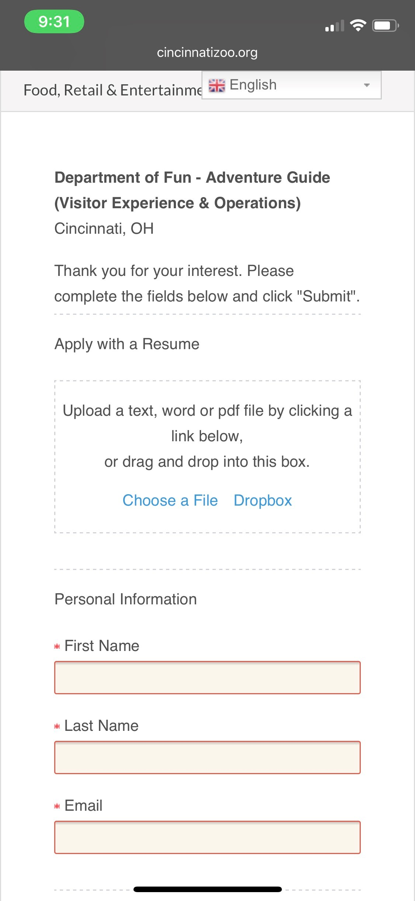
Empowering Every Persona
Nail Your Candidate and Internal Processes
When was the last time you tried applying for a position on your website?
Do you have a clear owner of recruiting inside of your business?
Do you understand who all has to be involved in the process of recruiting and hiring someone?
Are your hiring managers your allies?

Slide 22



Personas to Consider
Candidate
Hiring Manager
HRBP or Recruiter
Executives

Slide 23


Empowering Every Persona
Example: Candidate
What’s it like to be a candidate?
Features
Website – Easy to apply?
What’s Your First Impression Like?
Timely Communication - In Process/Beyond
Culture, Culture, Culture
Interviewers Enabled?

Slide 24
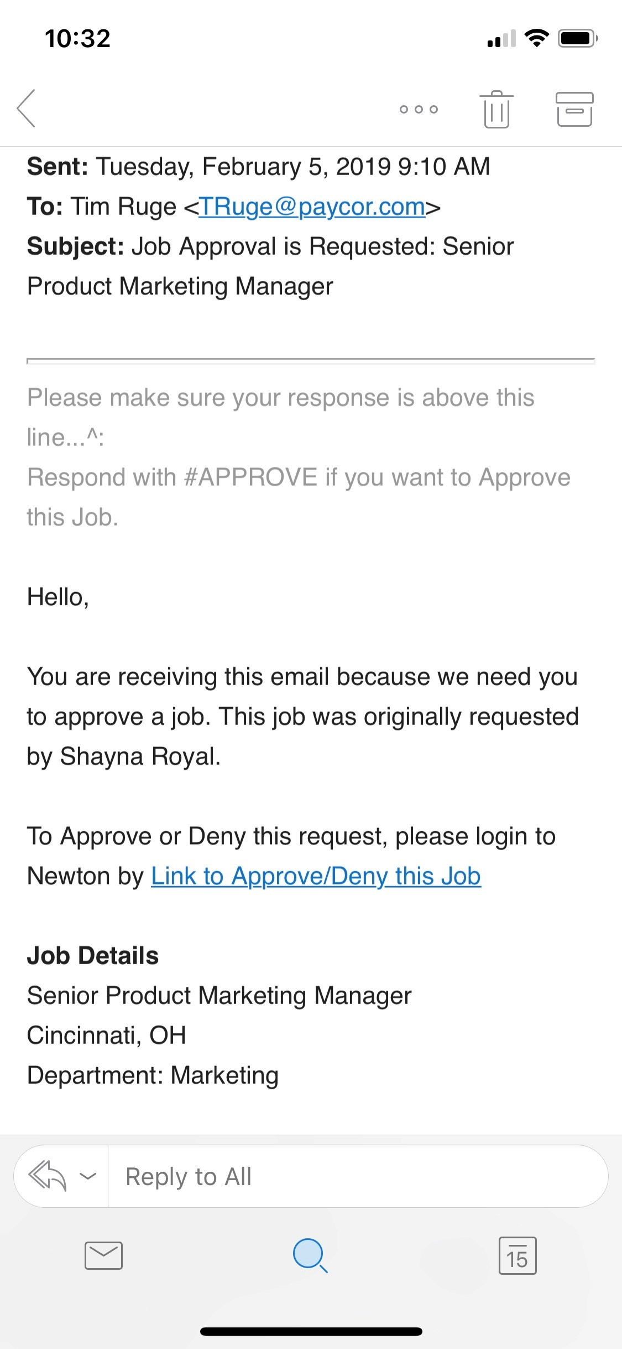
Empowering Every Persona
Example: Hiring Managers
What’s it like to be a hiring manager?
Features
Automatic interview scheduling
Simplified Resume Review
Email Activation – “Echo”
Interview Scorecards
Dashboards with “Overdue” Tasks

Slide 25
4. Communicate Results

Slide 26
66%
of CFOs say their HR departments have an “average or worse than average” impact on the organizations bottom line.
How is
HR Seen?
<10%
of an HR professionals time is spent aligning with or sharing impact executives.

Slide 27
Communicate Results
47%
Of HR Leaders said they don’t regularly share updates and metrics with Finance*
*2017 Paycor Market Trends Study

Slide 28




Measure What Matters
Proactive Measurement and Sharing
Develop Results Scorecard
Proactive Share of Reports/Details
Monthly/Quarterly Key Metrics Review
Share
Improvement Plans

Slide 29
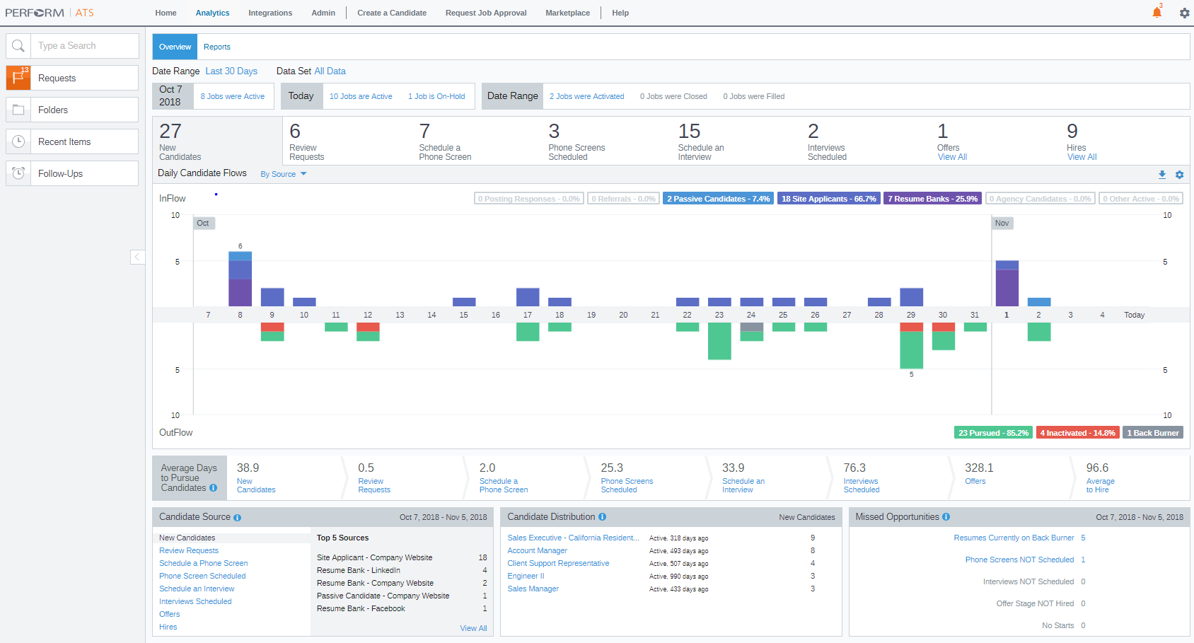

Slide 30
5. Consider the Full Lifecycle

Slide 31
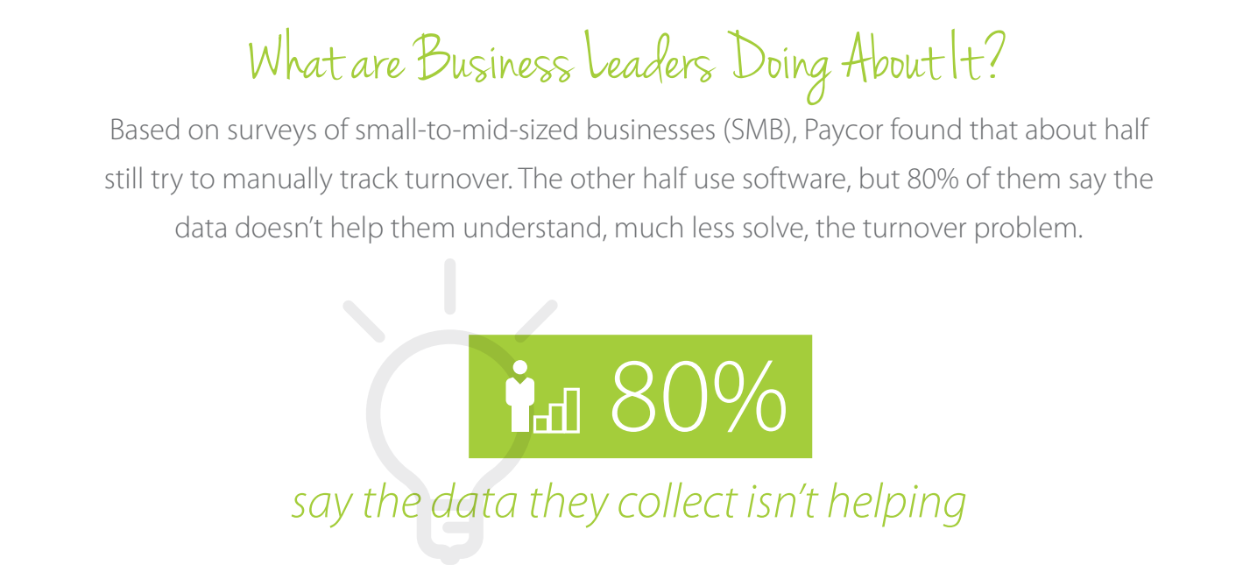
Turnover

Slide 32
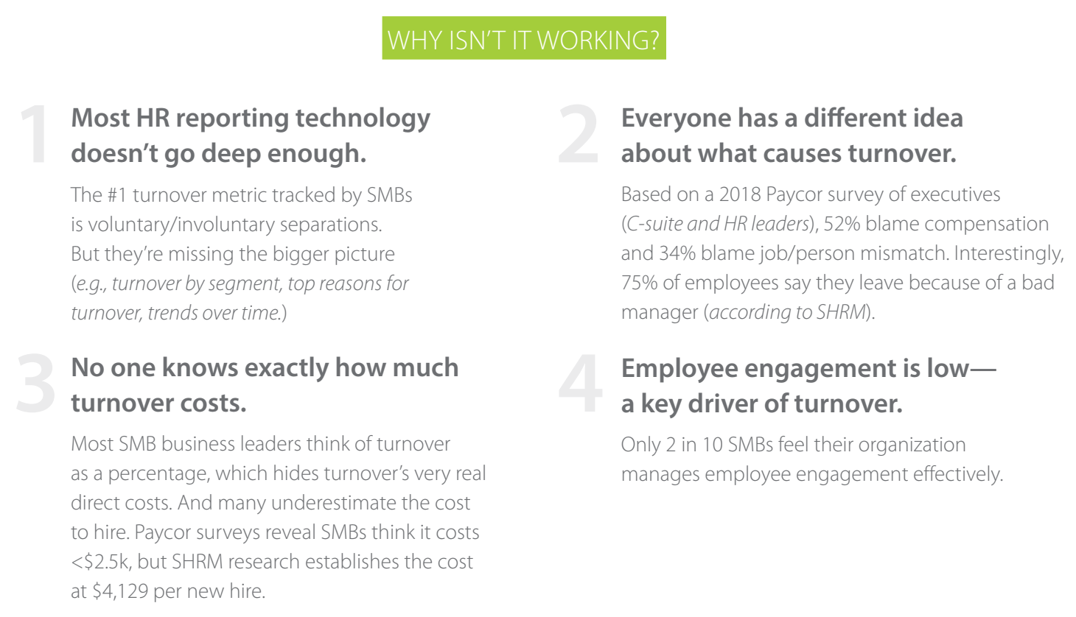

Slide 33
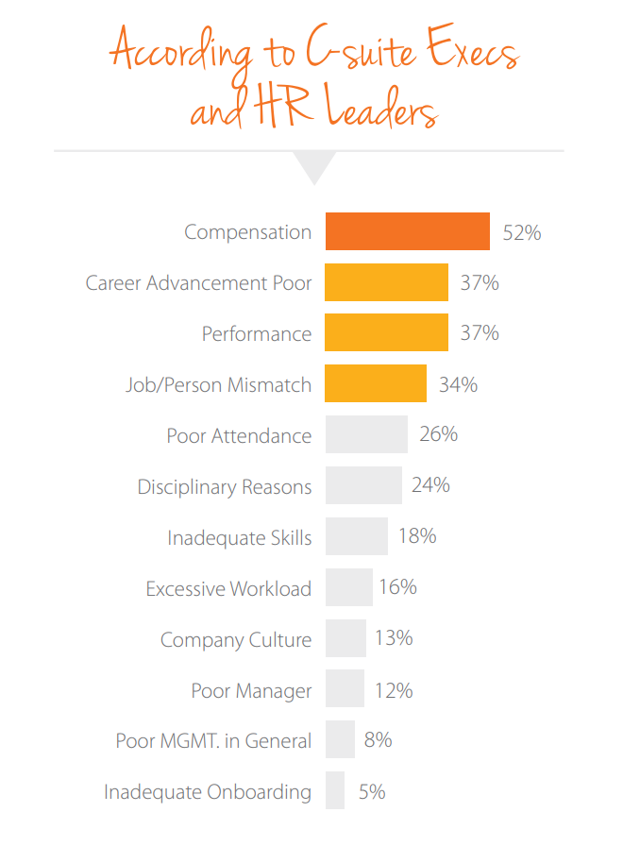
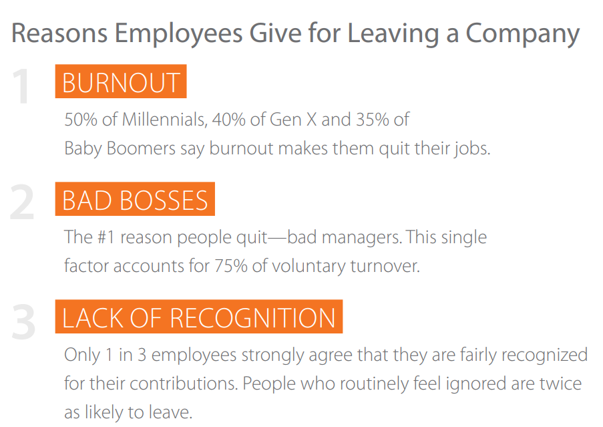

Slide 34
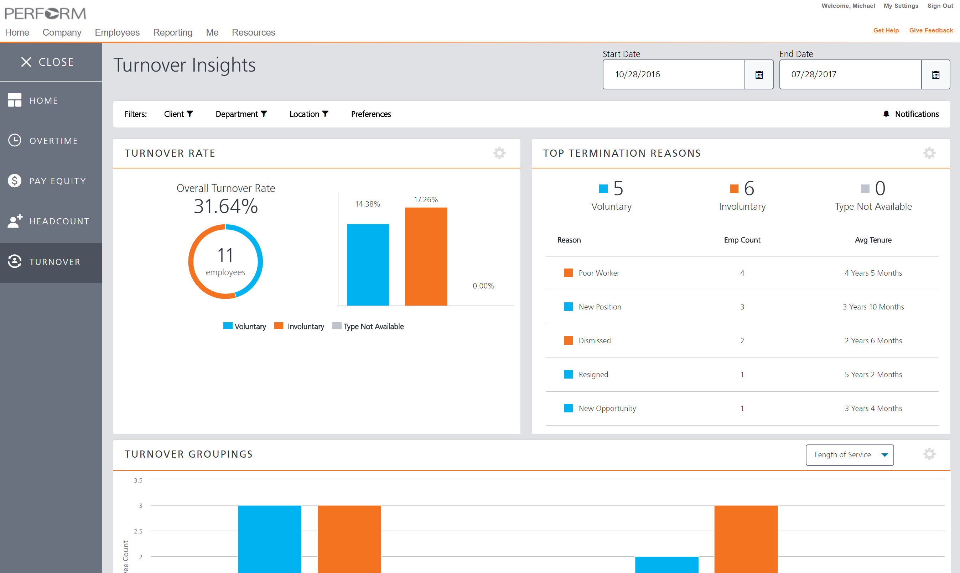

Slide 35



People Management
Four Key Areas of Focus
Key Metric = Turnover
Onboarding
Performance Management
Learning & Development
Day-to-day Manager & Employee Interactions

Slide 36

Impact of Metrics
Adding Up Your Core HR KPIs
Average Time to Fill
40 Days
Average Cost per Hire
$4,000
Turnover Rate
50%
36

Slide 37

Impact of Metrics
Adding Up Your Core HR KPIs
250 Employees
125 Employees
Avg = $4,000
Cost per Hire
$500,000 Total

Slide 38
Impact of Metrics
Adding Up Your Core HR KPIs
250 Employees
125 Employees
Avg = 40 Days
40,000 Hours
5,000 Days

Slide 39
Impact of Metrics
Adding Up Your Core HR KPIs
Average Time to Fill
40 Days
30 Days
Average Cost per Hire
$4,000
$3,500
Turnover Rate
50%
45%
39

Slide 40
Impact of Metrics
Adding Up Your Core HR KPIs
Turnover
Cost per Hire
Lost Productivity
125 Employees
112 Employees
$500,000
$392,000
5,000 Days
40,000 Hours
3,360 Days
26,880 Hours

Slide 41
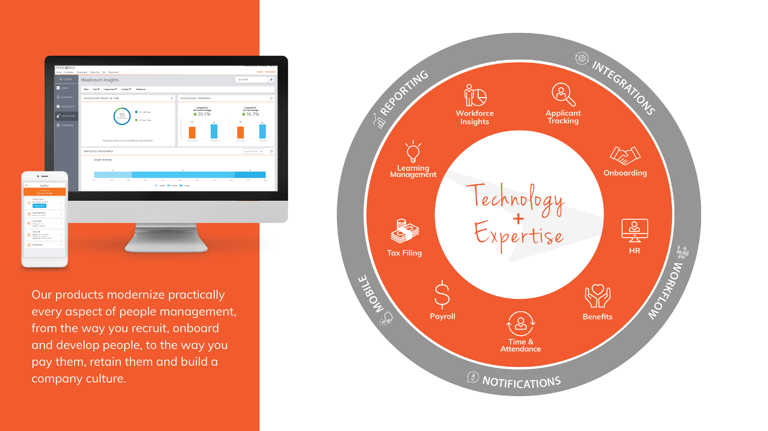

Slide 42
Questions?

